Slide 2
Why researchers need therapy, obituaries, and collages
Prepared by: Christopher Wardlaw

Slide 3
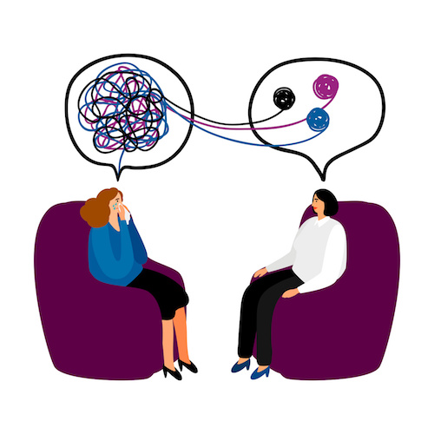
Therapy
3

Slide 4
Empathy is the capacity to understand and feel what another person is experiencing from within their frame of reference, that is, the capacity to place oneself in another's position.

Slide 5
Tips for a good “therapy“ session
Be an active listener
Be curious / play dumb
Be informal
Read and use body language
Be in control with being controlling
Don’t expect explicit answers to your research questions
Probe… probe … probe

Slide 6
Obituaries
6

Slide 7
Write an obituary for 7-Eleven
When did they die
How did they die
How would they be remembered
Who would miss them and why

Slide 8
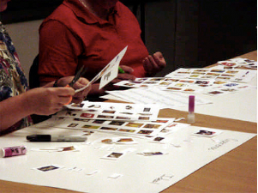
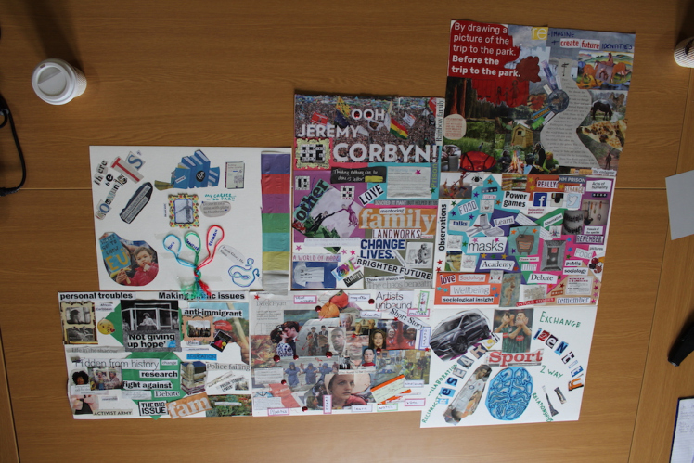
Collages
8

Slide 9
Tips for a good collage session
Have the respondent create a collage at home that represents themselves
Have the respondent bring several images depicting the topic you are going to discuss
Have the respondent go through their collage about themselves.
After covering their personal collage, have them create a collage with the items they brought in.
Have the respondent go over the new collage
Have the respondent compare and contrast the two collages

Slide 10
Questions?

